Slide 1
Department of Infrastructure
BERGRIVIER MUNICIPALITY CERTIFICATE HANDOVER
29 October 2024

Slide 2
Purpose
Phase IV Overall Performance (West Coast Municipalities)
Phase IV Bergrivier Municipality Performance
Phase IV Grant allocations – All West Coast municipalities
EPWP Phase V Objective and Targets

Slide 3
Phase IV Overall Performance (West Coast Municipalities)
Municipality | WO Target (2019-2024) | WO Achieved | % Achieved | FTE Target (2019-2024) | FTE Achieved | % Achieved
West Coast District | 610 | 740 | 121% | 193 | 261 | 135%
Matzikama | 1 965 | 2 650 | 135% | 491 | 613 | 125%
Cederberg | 1 951 | 1 991 | 102% | 668 | 501 | 75%
Bergrivier | 1 412 | 2 877 | 204% | 282 | 627 | 222%
Saldanha- Bay | 1593 | 2682 | 168% | 446 | 926 | 208%
Swartland | 1 334 | 2 979 | 223% | 645 | 715 | 111%
TOTAL | 8865 | 13919 | 157% | 2725 | 3643 | 134%
Source: 2019-2024 Q4 Annexures - NDPWI

Slide 4
Bergrivier Municipality Phase IV performance
Financial Year | WO Target | WO Achieved | % Achieved | FTE Target | FTE Achieved | % Achieved
2019/2020 | 298 | 797 | 267% | 55 | 165 | 300%
2020/2021 | 303 | 500 | 165% | 56 | 105 | 188%
2021/2022 | 310 | 676 | 218% | 56 | 139 | 248%
2022/2023 | 248 | 592 | 239% | 57 | 143 | 251%
2023/2024 | 253 | 418 | 165% | 58 | 128 | 221%
TOTAL | 1411 | 2983 | 211% | 282 | 680 | 241%
Source: 2019-2024 Q4 Annexures - NDPWI

Slide 5
Phase IV Grant Allocations
Municipality | 2019-20 Allocation | 2020-21 Allocation | 2021-22 Allocation | 2022-23 Allocation | 2023-24 Allocation | TOTAL
West Coast District | R1 422 000 | R2 135 000 | R2 075 000 | R1 662 000 | R2 873 000 (R2 712 000) | R10 006 000
Matzikama | R1 954 000 | R2 125 000 | R1 755 000 | R1 359 000 | R1 658 000 | R7 193 000
Cederberg | R1 578 000 | R1 940 000 | R1 836 000 | R1 569 000 | R3 028 000 (R2 859 000) | R9 782 000
Bergrivier | R2 502 000 | R2 870 000 | R2 646 000 | R2 907 000 | R2 125 000 | R13 050 000
Saldanha- Bay | R1 768 000 | R1 867 000 | R1 832 000 | R1 873 000 | R1 830 000 | R9 170 000
Swartland | R1 027 000 | R1 184 000 | R1 401 000 | R1 194 000 | R1 242 000 | R6 048 000
TOTAL | R10 251 000 | R12 117 000 | R11 545 000 | R10 564 000 | R12 756 000 (R12 426 000) | R55 249 000
*** Amounts in RED were the allocated to the Municipalities after the budget cuts in 2023/24 financial year.

Slide 6
EPWP Phase V Objective
The EPWP Objective:
“To provide the unemployed poor with meaningful work opportunities through the
delivery of community assets and services, and actively build economic inclusion
mechanisms that empower sustainable livelihoods and contribute to the country’s
development agenda.”

Slide 7
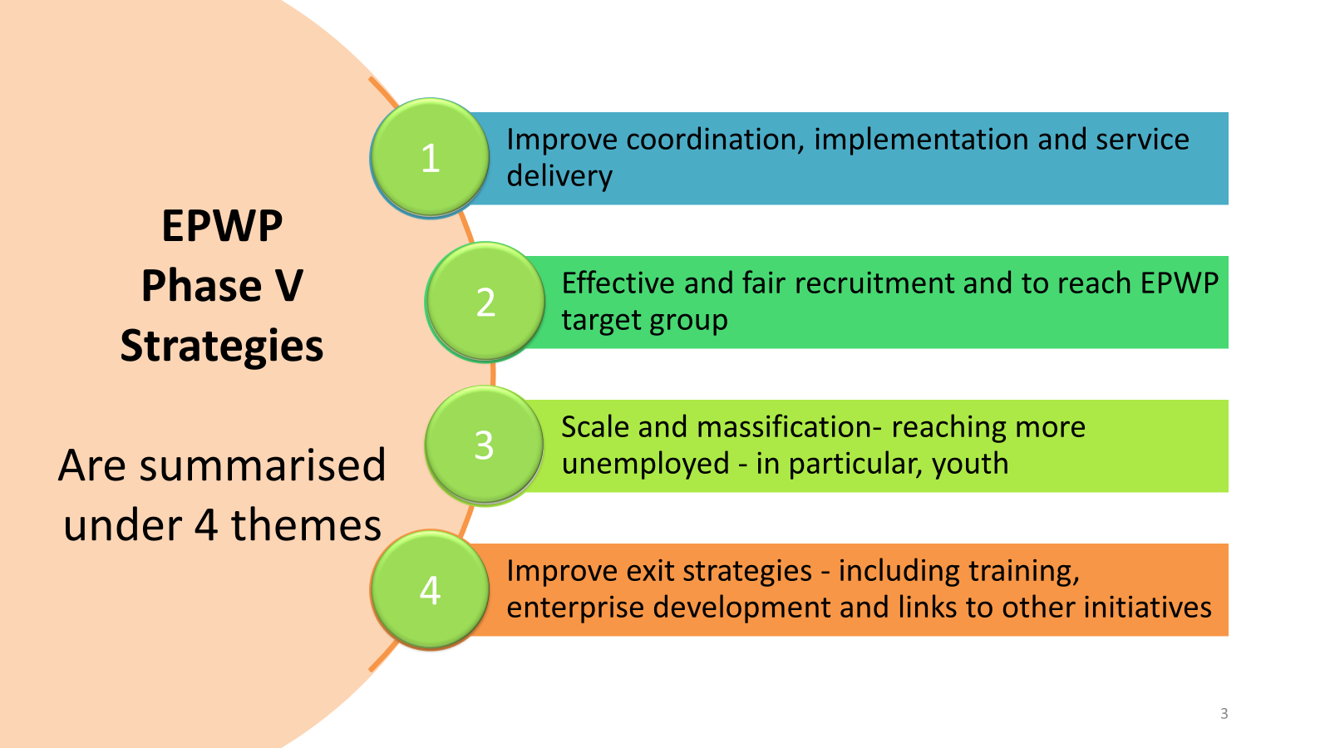
EPWP Phase V: EPWP Phase V was approved on the 21st February 2024 and implemented from 01 April 2024 to 31 March 2029
Phase 5 Target:
5million work opportunities.
Western Cape Phase 5 Target:
313 250
Over and above the 5 million work opportunities target, the target for designated groups in Phase V is as follows:
Women: 60%
Youth between 16 and 35: 55%
Persons with disabilities: 2%

Slide 8
Phase V Targets: Bergrivier Municipality (2024 -2029)
Financial Year | WO Target | FTE Target | Current Performance (23/10/2024)
 |  |  | WO | FTE
2024/2025 | 211 | 77 | 223(106%) | 42(55%)
2025/2026 | 215 | 78 | Grant allocation 2024/2025: R1 436 000
2026/2027 | 220 | 80
2027/2028 | 225 | 81
2028/2029 | 229 | 82
TOTAL | 1100 | 398

Slide 9
MT Rajap
Assistant Director: EPWP
Tel: 021 483 0953
Thabit.Rajap@westerncape.gov.za

